Slide 1
Introduction to basic concepts of McStas
Peter Willendrup

Slide 2
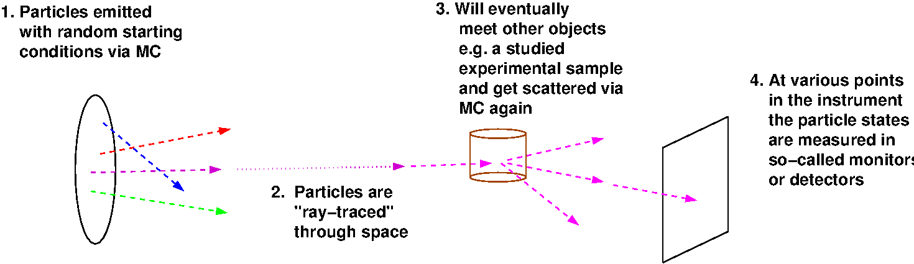
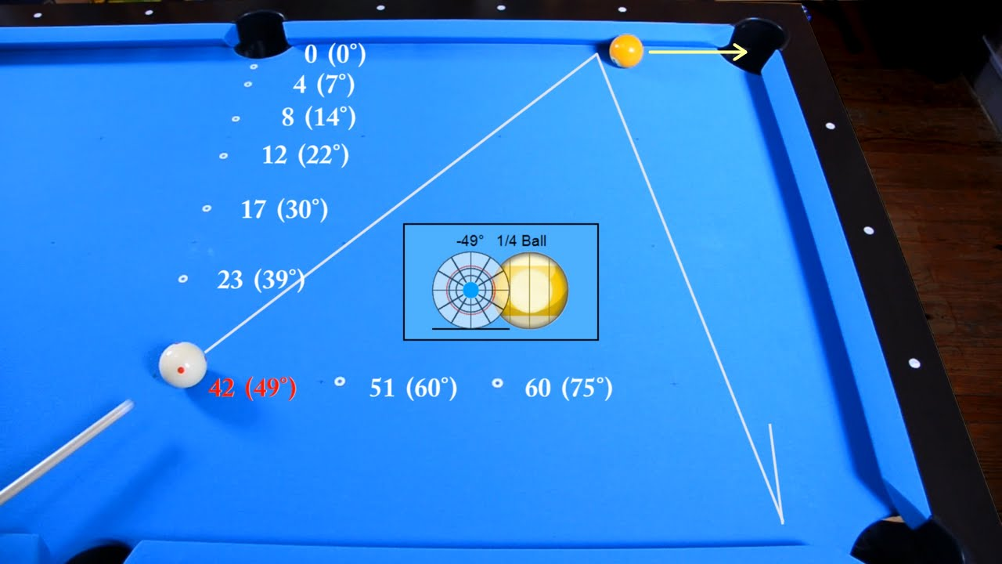
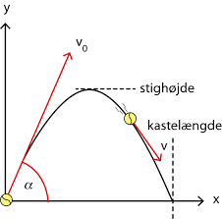
In the big picture, McStas is this…
Classical Newtonian mechanics, i.e. and
(independent, particles though…)

Slide 3
In the big picture, McStas is this…
Instrument
The instrument defines our “lab coordinate system”

Slide 4
In the big picture, McStas is this…
Instrument
Component
Component
Component
The instrument defines our “lab coordinate system”
The components define devices or features available in our instrument

Slide 5
In the big picture, McStas is this…
Instrument
Sample
Source
Monitor
The instrument defines our “lab coordinate system”
The components define devices or features available in our instrument - they have different function

Slide 6
In the big picture, McStas is this…
Instrument
Sample
Source
Monitor
Neutrons
The instrument defines our “lab coordinate system”
The components define devices or features available in our instrument - they have different function
Neutron particles are passed on from one component to the next, changing state under way

Slide 7
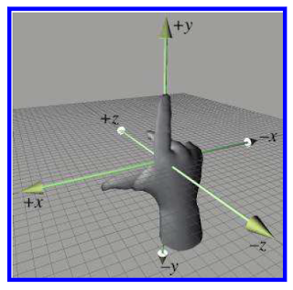
Placing components - source
One of the first components in your instrument is typically a source, which has a coordinate system like this….
z is along neutron beam direction
y is vertical
x at an angle of 90° wrt. z,y
y
x
z
Right-handed
coordinate system

Slide 8
Placing components - source
Often the source coordinate system coincides with the “lab” coordinate system, denoted ABSOLUTE in McStas language, i.e.
COMPONENT Source = Source_simple(…) AT (0,0,0) ABSOLUTE
y
x
z

Slide 9
Placing further components - RELATIVE
Placing further components is done by order of 1. Location, i.e
COMPONENT Source = Source_simple(…) AT (0,0,0) ABSOLUTE
y
y´
x
x´
z
z’
COMPONENT Guide = Guide(…) AT (0,0,1) RELATIVE Source

Slide 10
Placing further components - RELATIVE
Placing further components is done by order of 2. Rotation, i.e
COMPONENT Source = Source_simple(…) AT (0,0,0) ABSOLUTE
y
y´
x
x”
x´
z”
z
z’
COMPONENT Guide = Guide(…) AT (0,0,1) RELATIVE Source
ROTATED (0,30,0) RELATIVE Source
(Reference labels can also be PREVIOUS or PREVIOUS+1 etc.)

Slide 11
Components often have their origin at the centre of mass, i.e. for samples … but not for neutron guides
y´
y
x
x´
z
z’
Generally speaking, the component author can choose
the meaningful coordinate system for the given problem!
- The McStas system takes care of the transformation between them….

Slide 12
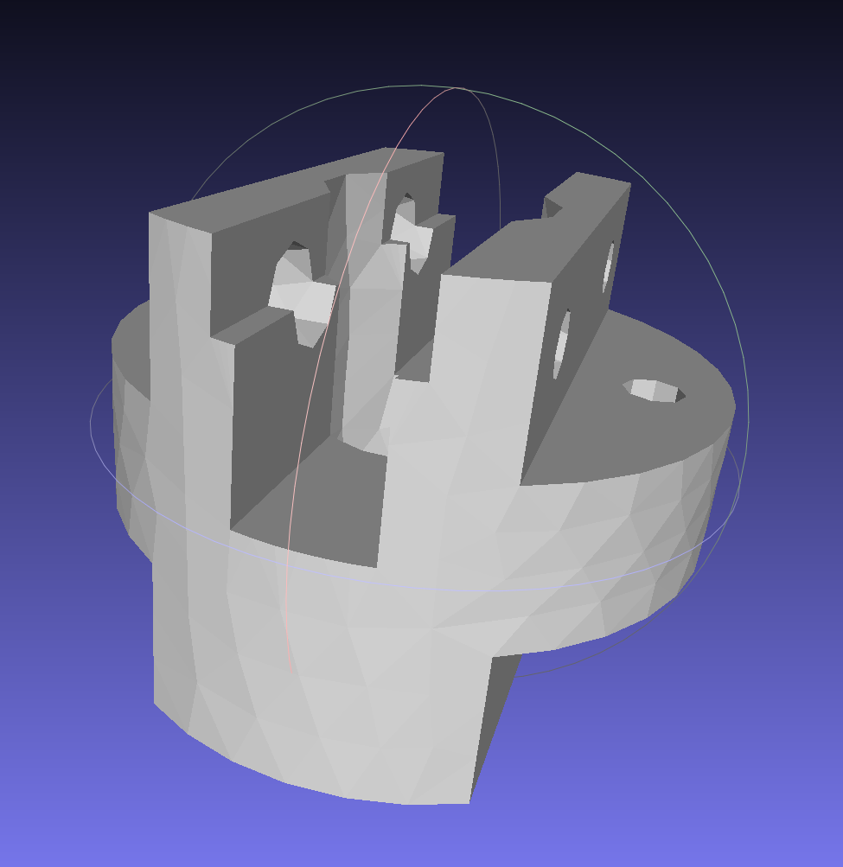
Component geometries are typically simple objects… But some have polygon-description of the surface
2D
3D

Slide 13
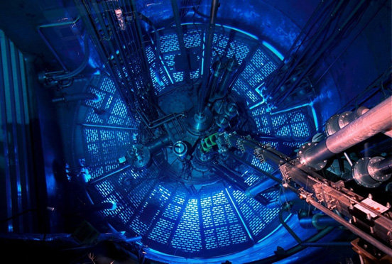
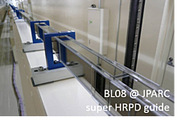
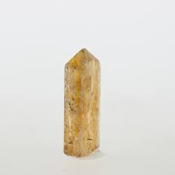
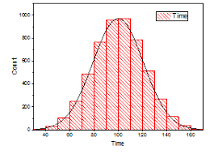


Component classes
Sources - these define MC starting conditions / “inject” neutrons to our simulation
Optics - used to tailor properties of the neutron beam
Examples are mirrors, guides, choppers, collimators, slits, …
Samples - “matter” of some form
Powders, single crystals, liquids, micelles in solution, reflecting surfaces…
Monitors - may probe the state of the neutron beam and store histograms / event lists
Misc, obsolete
“Other stuff” and “Old stuff”

Slide 14
Component classes
Sources - these define MC starting conditions / “inject” neutrons to our simulation
Optics - used to tailor properties of the neutron beam
Examples are mirrors, guides, choppers, collimators, slits, …
Samples - “matter” of some form
Powders, single crystals, liquids, micelles in solution, reflecting surfaces…
Monitors - may probe the state of the neutron beam and store histograms / event lists
Misc, obsolete
“Other stuff” and “Old stuff”
Common to all components:
They set, manipulate/interact with
or measure the state of the neutron (ray)

Slide 15
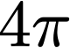
Neutron sources, i.e. moderators
To first order emit uniformly into steradian

Slide 16





Neutron sources, i.e. moderators
Generally we are intersted in the input to a single instrument, characterised by a certain solid angle , often corresponding to a rectangle x at a distance from the source
E.g. the beamport?

Slide 17
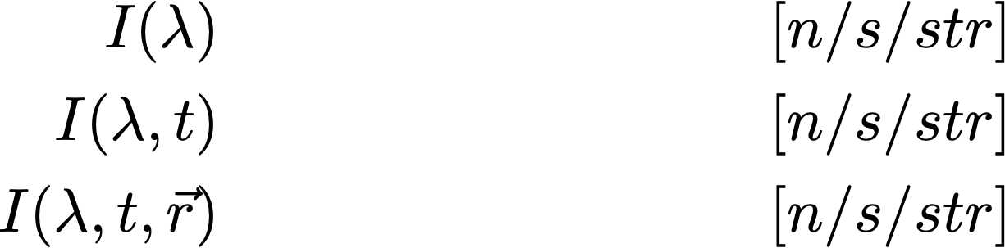
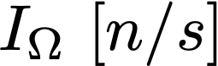
Neutron sources, i.e. moderators
The emmission intensity into our chosen solid angle can be a function of wavelength, time (pulsed sources) and possibly point of origin on the source surface
The emission of particles into the solid angle is in fact an integration and leads to a simulated “intensity” of .
In McStas, that integrated intensity is partitioned over a given set of particle rays referred to as ncount, -n or --ncount
The default ncount is 1e6 rays

Slide 18
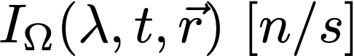

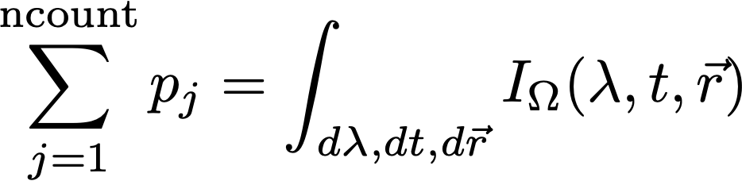
Neutron sources, i.e. moderators
Our neutron rays are emitted randomly, sampling and all variables of the source “spectrum”, i.e. wavelength, time and area
assigning neutron weights such that

Slide 19
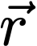

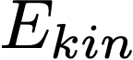
Neutron rays in McStas - what are they?
Neutron ray in McStas:
Location x,y,z
Velocity vx,vy,vz
Time t
Polarisation. sx,sy,sz
Intensity p
Defining the neutron starting conditions imply setting:
The starting point on the surface, i.e. (in the code variables x,y,z)
The direction into and our / (in the code variables vx,vy,vz)
The starting time (in the code the variable t)
The initial intensity / weight of the neutron ray (in the code the variable p)
If needed the initial polarisation (in the code the variables sx,sy,sz)

Slide 20
Neutron (ray)-matter interaction 1: reflecting surface
1 starting situation
Mirror surface
Neutron ray
(x,y,z,vx,vy,vz,t,sx,sy,sz,p)
0

Slide 21
Neutron (ray)-matter interaction 1: reflecting surface
2. Propagate to the mirror surface
(x,y,z,vx,vy,vz,t,sx,sy,sz,p)
1
(x,y,z,vx,vy,vz,t,sx,sy,sz,p)
0

Slide 22
Neutron (ray)-matter interaction 1: reflecting surface
3. Checks (are we on surface, what is probability of reflection etc.)
(x,y,z,vx,vy,vz,t,sx,sy,sz,p)
1
(x,y,z,vx,vy,vz,t,sx,sy,sz,p)
0

Slide 23
Neutron (ray)-matter interaction 1: reflecting surface
4. Reflect
(x,y,z,vx,vy,vz,t,sx,sy,sz,p)
1
(x,y,z,vx,vy,vz,t,sx,sy,sz,p)
0
(x,y,z,vx,vy,vz,t,sx,sy,sz,p)
2
Weight of final ray is adjusted according to reflectivity, see next slide

Slide 24
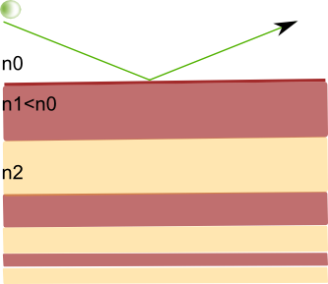
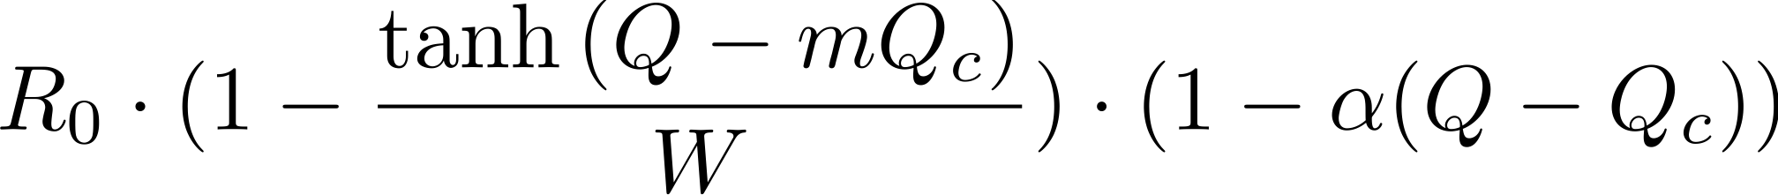
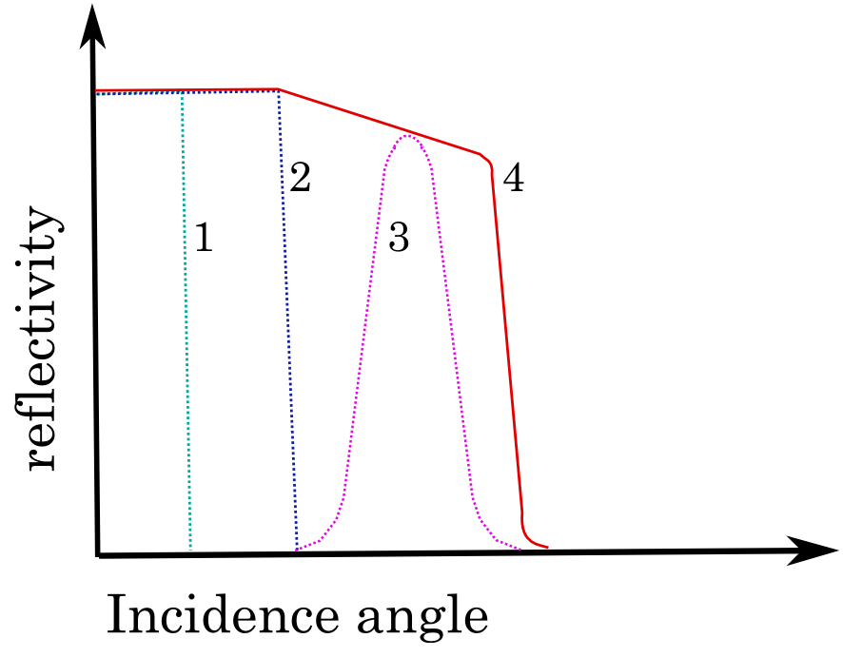
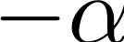

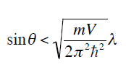
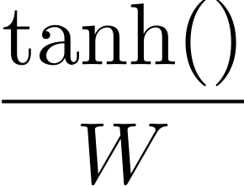
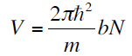
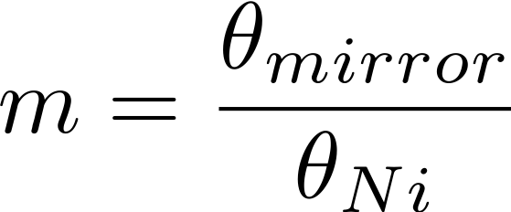



Parametrisation of reflectivity on mirrors etc.
d
R
(i.e. Q is calculated for given neutron, reflectivity encoded in changed p value)

Slide 25
Neutron (ray)-matter interaction in General
A neutron hitting a sample can be:
absorbed, transmitted, or scattered

Slide 26
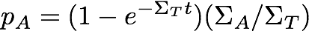
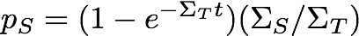
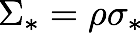
Samples
For a non-thin sample the probabilities for absorption, transmission or scattering are given by
t = sample thickness
macroscopic cross section [cm⁻¹]
microscopic cross section [barn/atom]
1 barn = 10⁻²⁴cm²
number density [atoms/cm³]

Slide 27
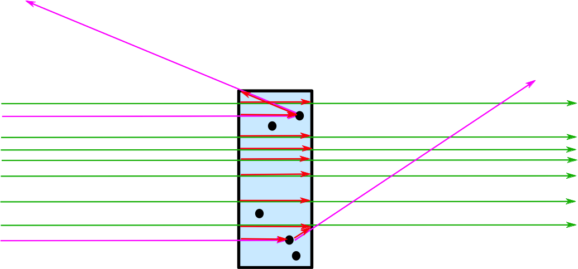
Samples/Matter interaction in General in McStas
A neutron ray hitting a sample can be:
transmitted+absorption, or scattered+absorption

Slide 28
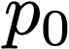
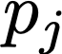
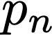
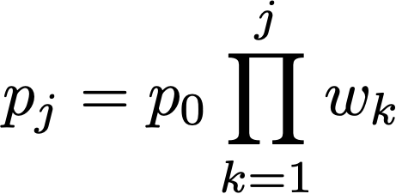
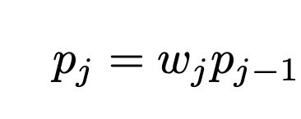
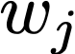
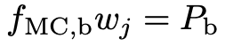
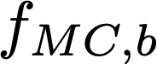
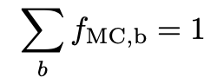
Transport of weight through the instrument…
In a given component, the neutron intensity is adjusted by a multiplicative factor (probability)
Instrument
Sample
Source
Monitor
The weight multiplier of the j’th component, , is calculated by the probability rule where Pb is the physical probability for the event ”b“, and is the probability that the Monte Carlo simulation selects this event.
In case of “branching”, i.e. multiple outcomes, it is clear that

Slide 29
To first order, McStas is linear and follows sequence of components in your file…
1
3
2
1
2
3
Starting at the source

Slide 30
To first order, McStas is linear and follows sequence of components in your file…
1
3
2
1
2
3
Moving to first comp in the list

Slide 31
To first order, McStas is linear and follows sequence of components in your file…
1
3
2
1
2
3
Moving to 3rd comp in list requires “moving back in time”.
Default behavior is to ABSORB this type of neutron.
For monitors use restore_neutron=1 in this case.
For homegrown comps use ALLOW_BACKPROP macro.

Slide 32
To first order, McStas is linear and follows sequence of components in your file…
The order of components is important,
and in general overlaps should be avoided!
1
3
2
1
2
3
Moving to 3rd comp in list requires “moving back in time”.
Default behavior is to ABSORB this type of neutron.
For monitors use restore_neutron=1 in this case.
For homegrown comps use ALLOW_BACKPROP macro.

Slide 33


Units used - and differences to Vitess
Generally SI-Units, e.g. meters and seconds etc.
Added neutron-scattering meaningful quantities of E[meV], 𝝺[Å] and cross sections in 𝞂 [barns]
Main differences / difficulties translating between McStas Vitess
Different length-units for placement / sizes [m] [cm]
Different propagation-coordinate system
McStas explicitly and automatically contains “free space”, Vitess has this “inside” the modules or by adding “spacewindow”
Sources in McStas always propagates “by virtual window”, i.e. does not itself propagate
z || beam
y vertical
x ⊥ beam
x || beam
z vertical
y ⊥ beam

Slide 34
McStas Vitess compatibility features
MCPL particle list is supported from McStas 2.3- (2016) and Vitess 3.4 (2018)
McStas includes Vitess_output and Vitess_input, but better use MCPL
mcstas2vitess can be used to port McStas components to Vitess
Vitess_ChopperFermi is the Vitess Fermi chopper ported to McStas
Friendly competition and collaboration for 1.5 decades! - e.g. Klaus Lieutenant was part of McStas team for 2 years

